Slide 1

NML-WG
OGF 37, Charlottesville

Slide 2
OGF IPR Policies Apply
“I acknowledge that participation in this meeting is subject to the OGF Intellectual Property Policy.”
Intellectual Property Notices Note Well: All statements related to the activities of the OGF and addressed to the OGF are subject to all provisions of Appendix B of GFD-C.1, which grants to the OGF and its participants certain licenses and rights in such statements. Such statements include verbal statements in OGF meetings […]
Excerpt from Appendix B of GFD-C.1: ”Where the OGF knows of rights, or claimed rights, the OGF secretariat shall attempt to obtain from the claimant of such rights, a written assurance that upon approval by the GFSG of the relevant OGF document(s), any party will be able to obtain the right to implement, use and distribute the technology or works when implementing, using or distributing technology based upon the specific specification(s) under openly specified, reasonable, non-discriminatory terms. The working group or research group proposing the use of the technology with respect to which the proprietary rights are claimed may assist the OGF secretariat in this effort. The results of this procedure shall not affect advancement of document, except that the GFSG may defer approval where a delay may facilitate the obtaining of such assurances. The results will, however, be recorded by the OGF Secretariat, and made available. The GFSG may also direct that a summary of the results be included in any GFD published containing the specification.”
Notes:
IPR Notices Note Well for OGF meetings

Slide 3
OGF IPR Policies Apply
Some works (e.g., works of the U.S. government) are not subject to copyright. However, to the extent that the submission is or may be subject to copyright, the contributor, the organization he or she represents (if any), and the owners of any proprietary rights in the contribution grant an unlimited perpetual, non-exclusive, royalty-free, worldwide right and license to the Open Grid Forum under any copyrights in the contribution. This license includes the right to copy, publish, and distribute the contribution in any way and to prepare derivative works that are based on or incorporate all or part of the contribution, the license to such derivative works to be of the same scope as the license of the original contribution.
The contributor acknowledges that the Open Grid Forum has no duty to publish or otherwise use or disseminate any contribution.
The contributor grants permission to reference the name(s) and address(es) of the contributor(s) and of the organization(s) he or she represents (if any).
The contributor represents that contribution properly acknowledges major contributors.
The contributor, the organization (if any) he or she represents, and the owners of any proprietary rights in the contribution agree that no information in the contribution is confidential and that the Open Grid Forum and its affiliated organizations may freely disclose any information in the contribution.
The contributor represents that he or she has disclosed the existence of any proprietary or intellectual property rights in the contribution that are reasonably and personally known to the contributor. The contributor does not represent that he or she personally knows of all potentially pertinent proprietary and intellectual property rights owned or claimed by the organization he or she represents (if any) or by third parties.
The contributor represents that there are no limits to the contributor's ability to make the grants acknowledgments and agreements above that are reasonably and personally known to the contributor.
Notes:
IPR Notices Note Well for OGF meetings

Slide 4
Agenda
NML-base document
Status
Short overview of features
Future works
Recharter or close the WG
JSON syntax
Ethernet extensions (required for NSI)
DWDM extensions
Additional (‘experimental’) Features
OpenFlow extensions

Slide 5
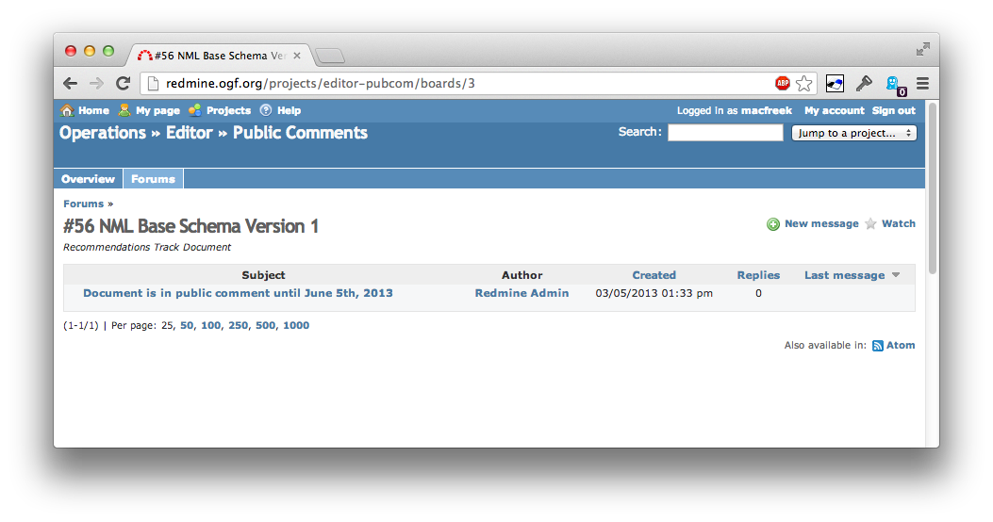
NML-base
http://redmine.ogf.org/projects/editor-pubcom/boards

Slide 6
NML-base: Table of Contents
Introduction
NML Base Schema
Classes
Relations
Attributes
Parameters
Identifiers
Syntax
XML Syntax
OWL Syntax
Examples
Security Considerations

Slide 7
NML-base: Objects

Slide 8
NML-base: Relations
Example: hasNode

Slide 9
Future Work
Recharter or close the WG
JSON syntax - Jeroen
Ethernet extensions (required for NSI) – Freek & Jerry (NSI)
DWDM extensions
Additional (‘experimental’) Features –Freek
IP extensions - Henrik
(OpenFlow extensions/BCP?)
-12months describe Experience Doc

Slide 10
Group Charter (relevant parts)
Charter for NML-WG
Date 2013-03-12
Group Abbreviation:
nml-wg
Group Name:
Network Mark-up Language Working Group
Area:
Infrastructure
[....]
Timeline
GGF 19 (feb 2007):
- official start of working group
[...]
GGF 24 (sep 2008):
- official closure of working group

